Slide 1


Mini-Project 1
Mariluz Beltran

Slide 2
GOAL
Converting a Figma design to HTML and CSS involves a process known as front-end development. This process includes translating the visual design elements and layout from Figma into actual code that can be displayed in a web browser. Here’s my step-by-step guide on how to do it:
1. Prepare my Figma Design Slide 4
2. Set Up my Mini Project-1
3. HTML Structure HTML STRUCTURE
4. CSS Styling CSS STYLING
5. HTML Content
6. Add Images, Test and Refine
7. Responsive Design

Slide 3
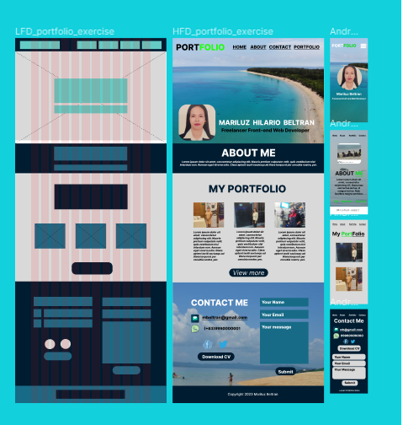
Figma Low & High Fidelity Design-Target Output

Slide 4
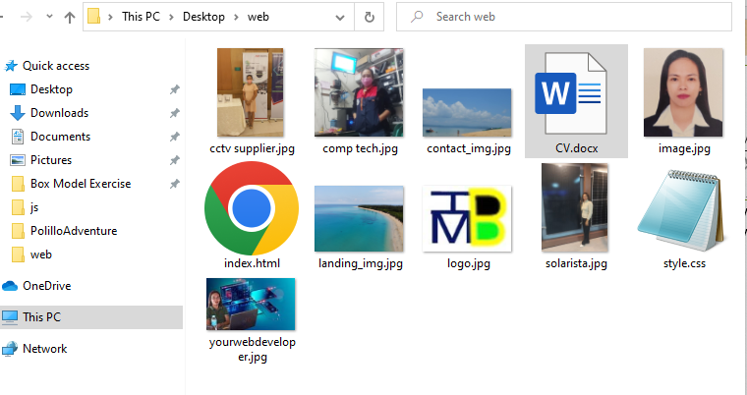
SET UP MY MINI PROJECT 1

Slide 5
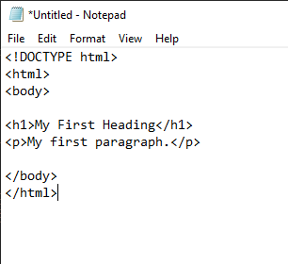
HTML STRUCTURE

Slide 6
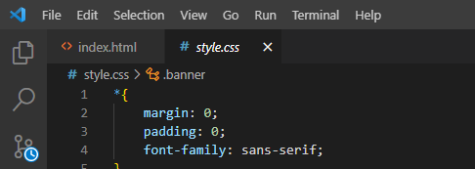
CSS STYLING

Slide 7
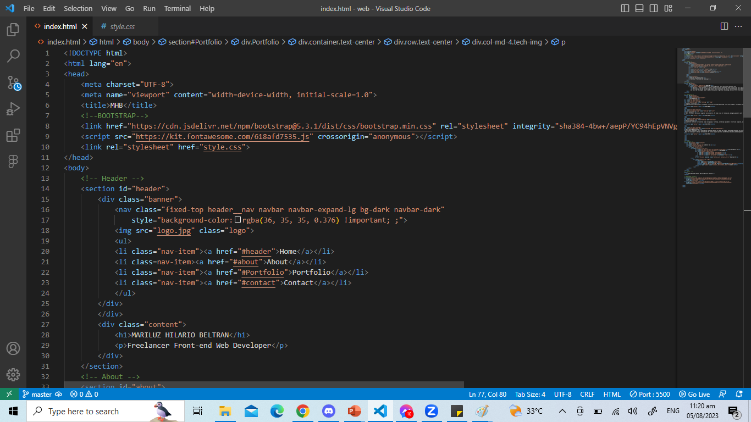
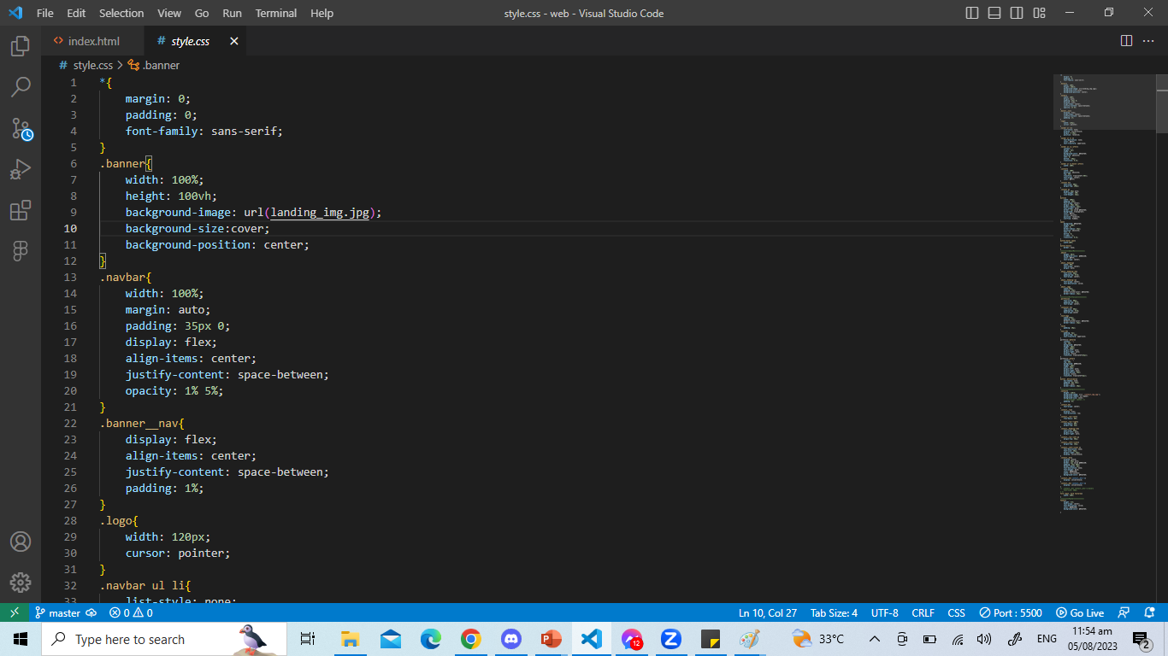
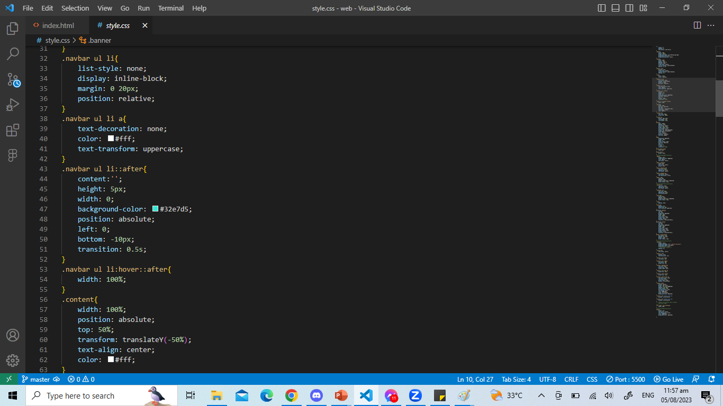
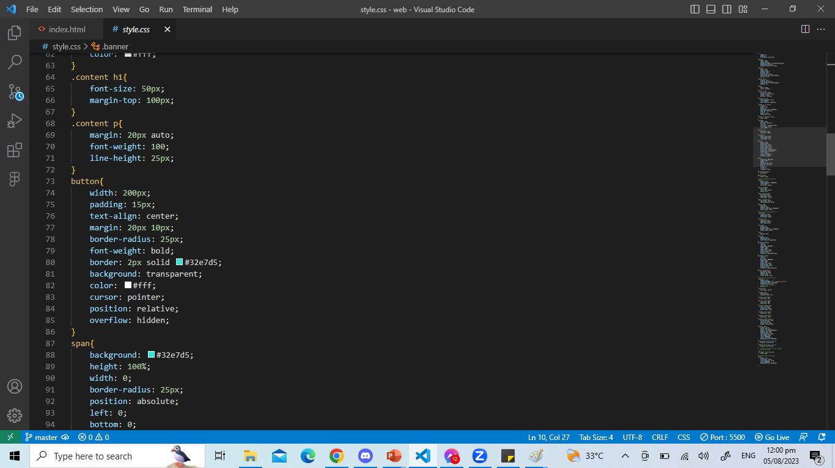
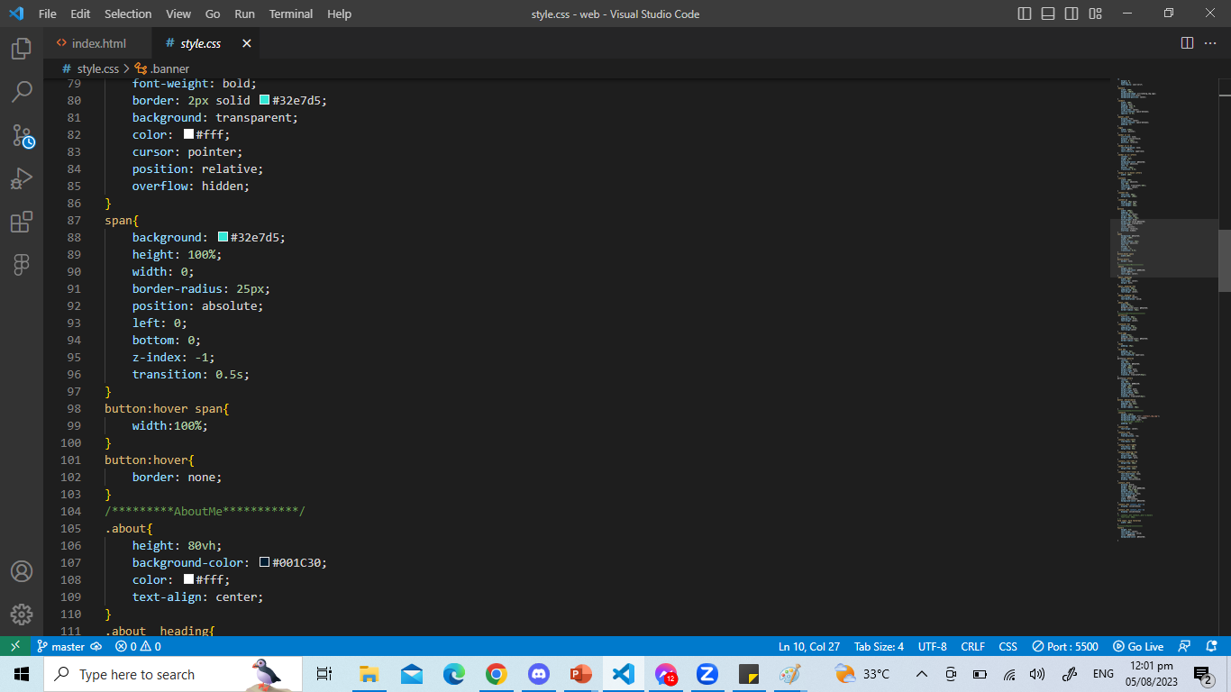

HEADER HTML CSS
HTML AND CSS CONTENT

Slide 8
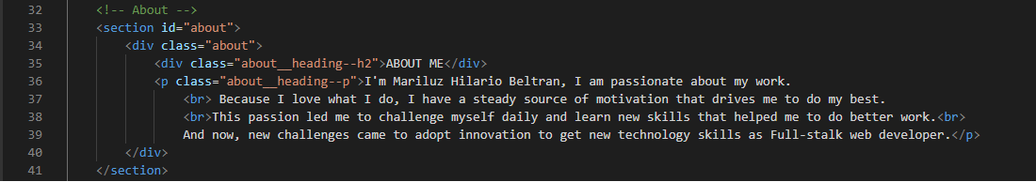
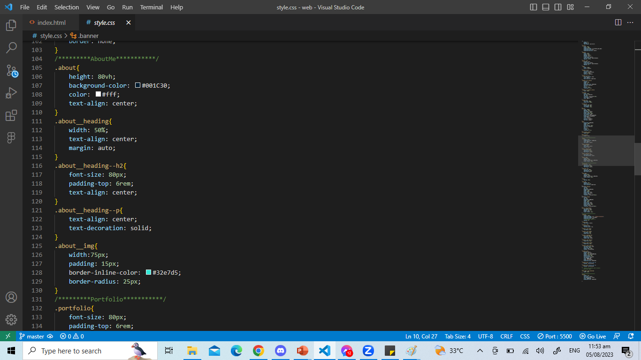

ABOUT HTML CSS

Slide 9
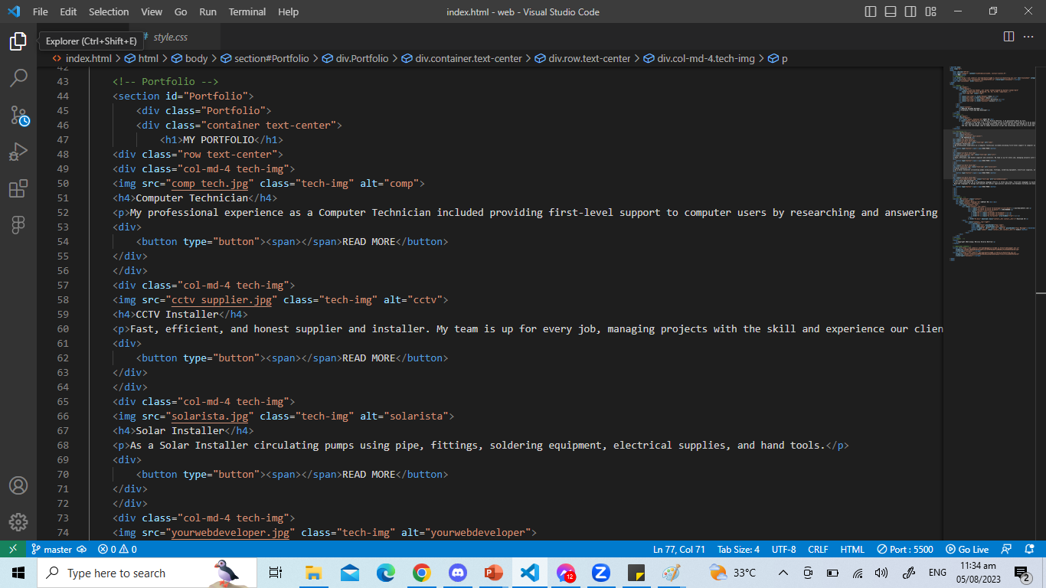
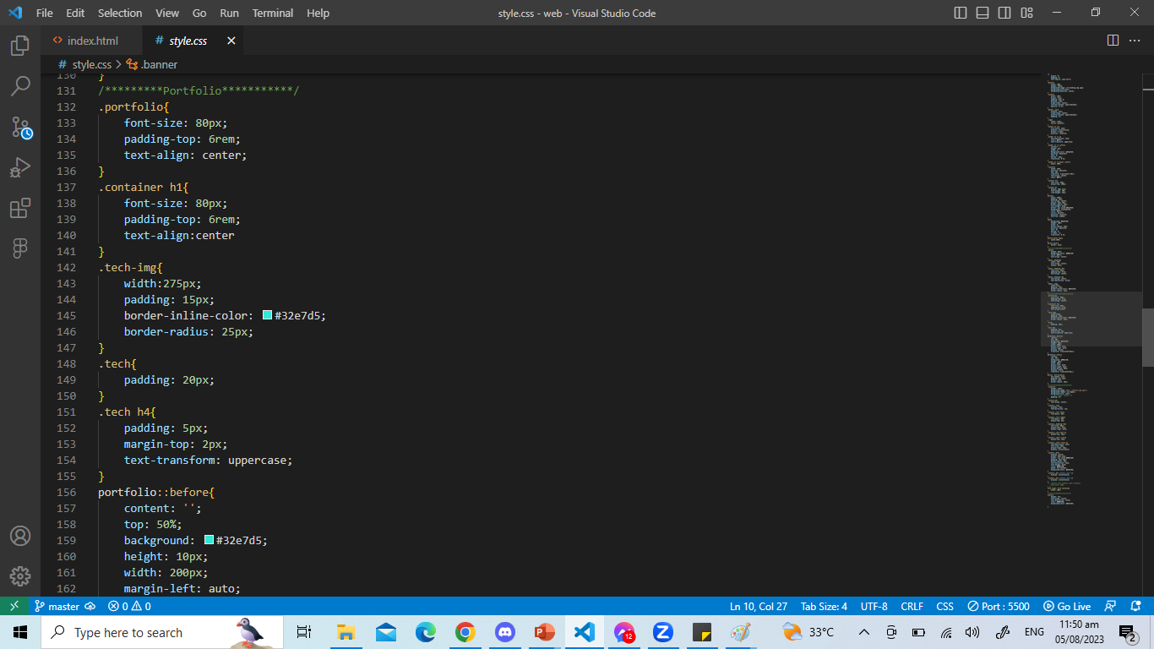
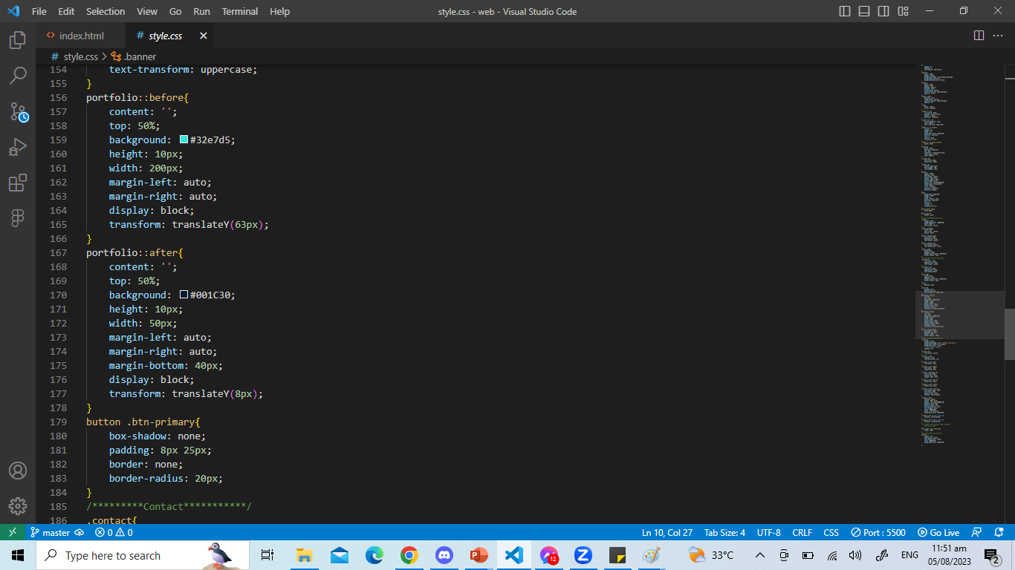

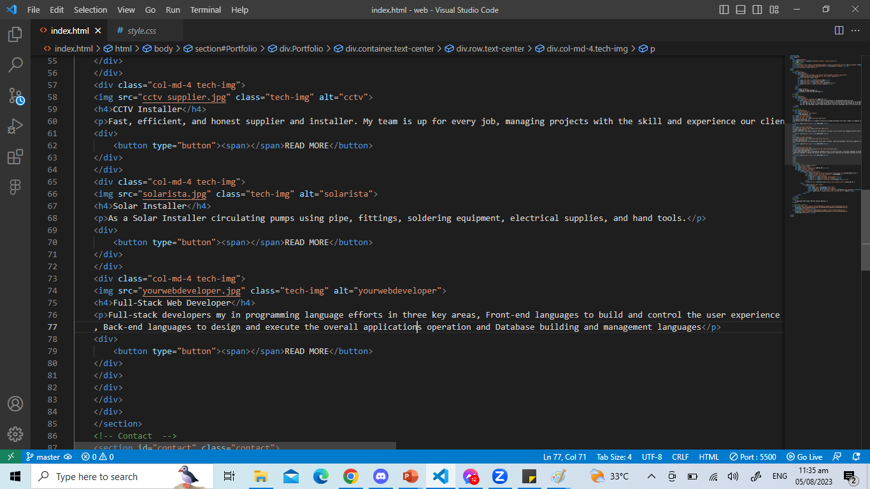
PORTFOLIO HTML CSS

Slide 10
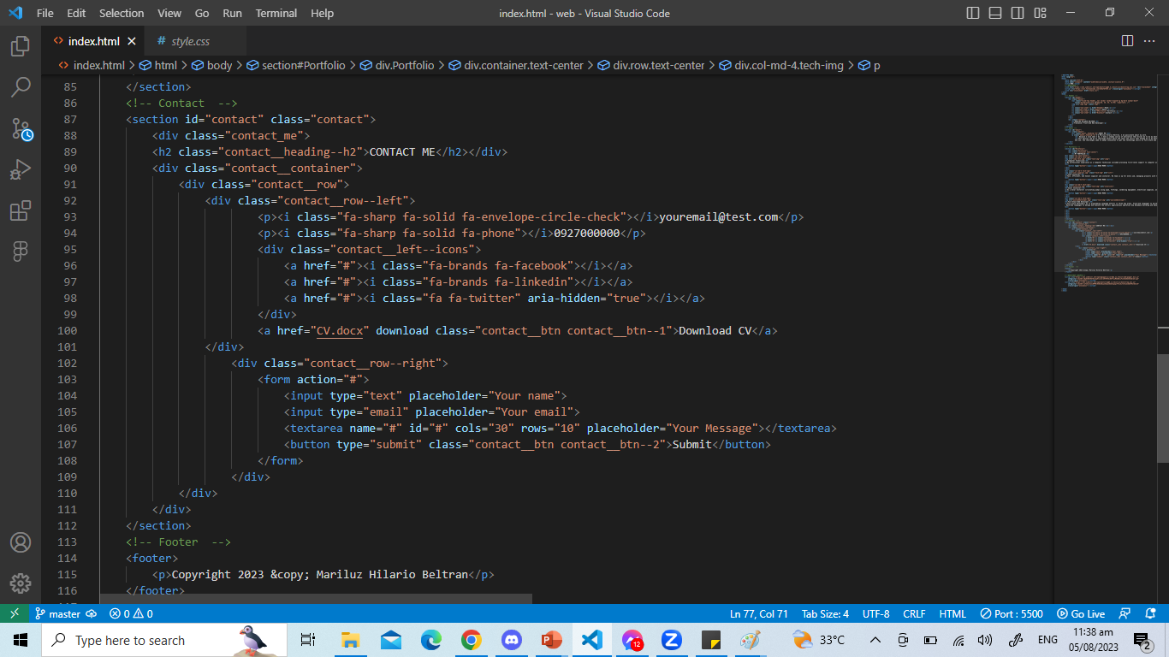
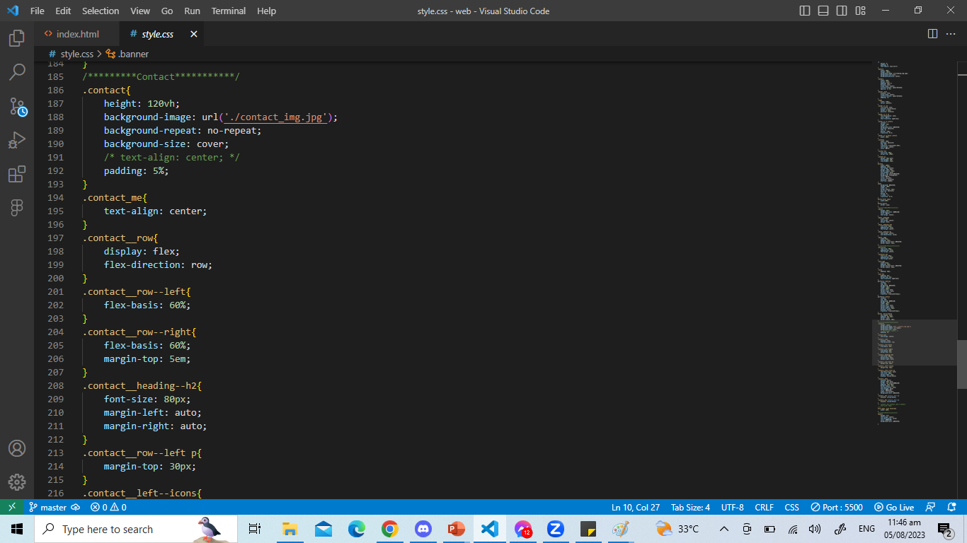
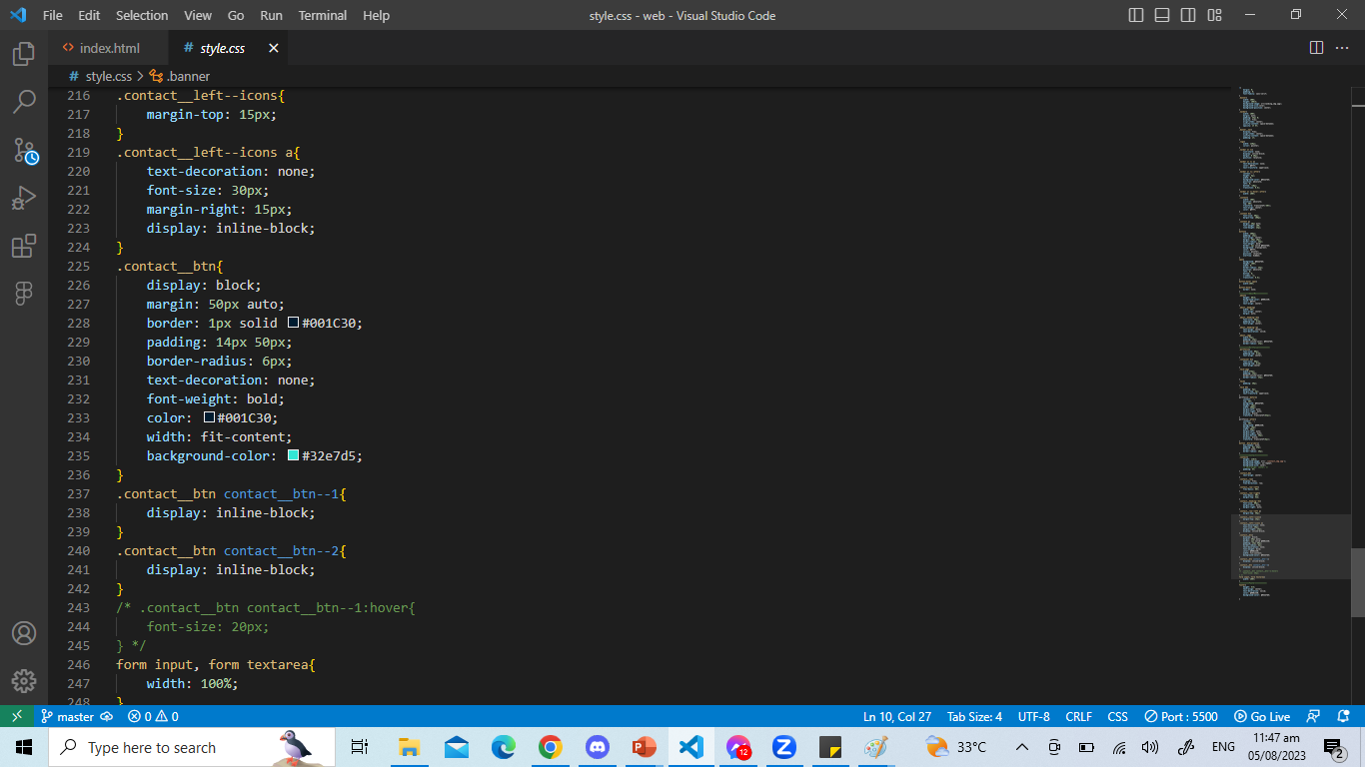
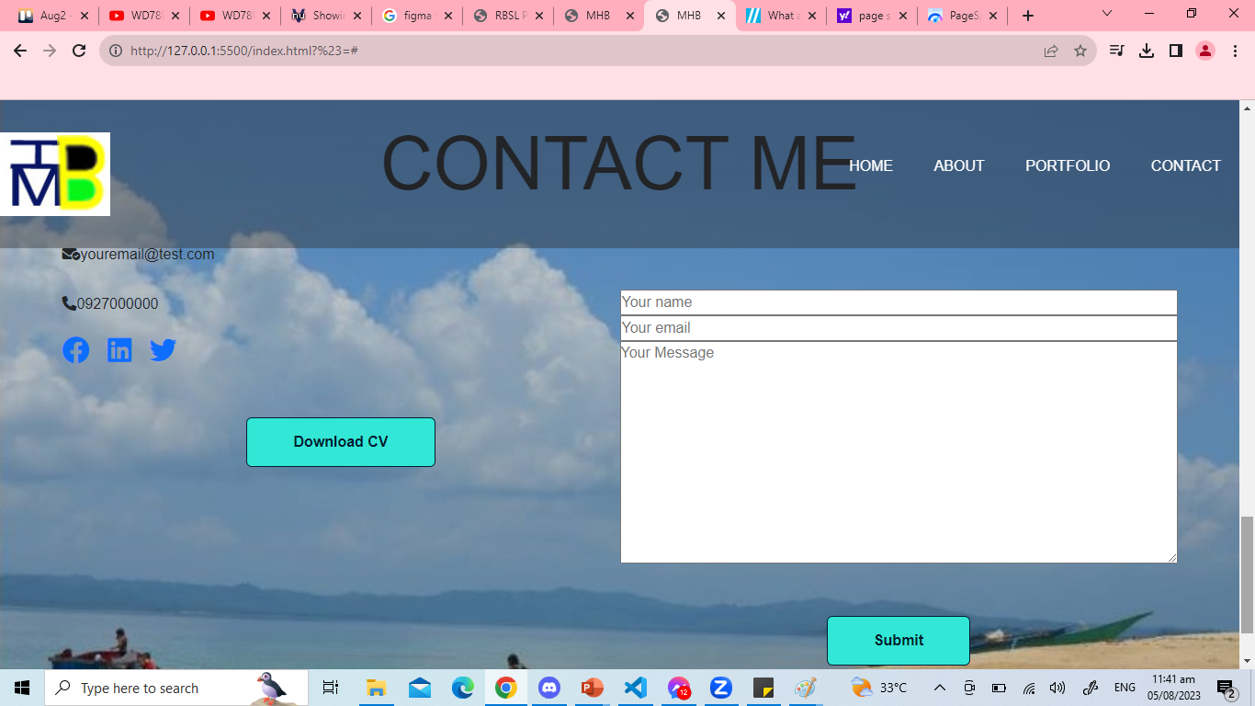
CONTACT HTML CSS

Slide 11
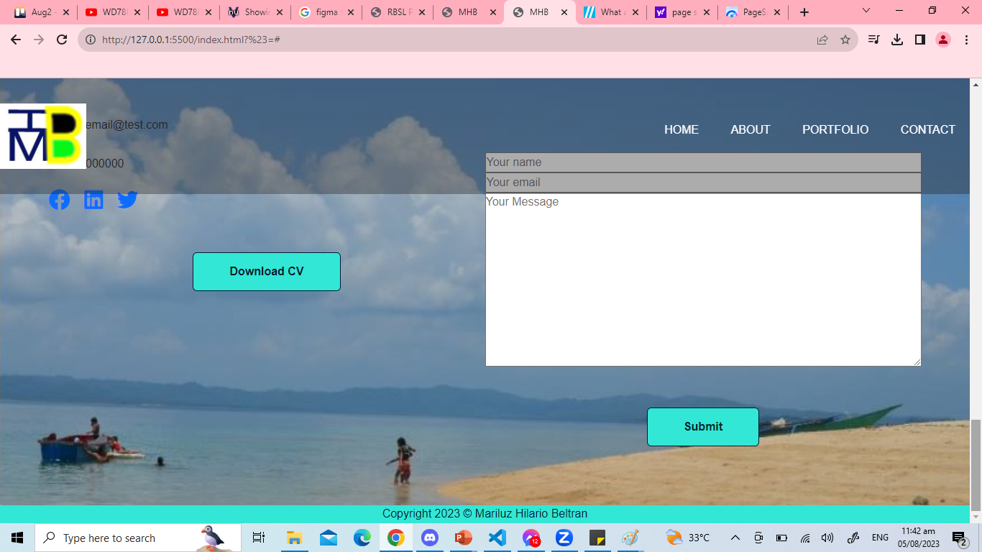
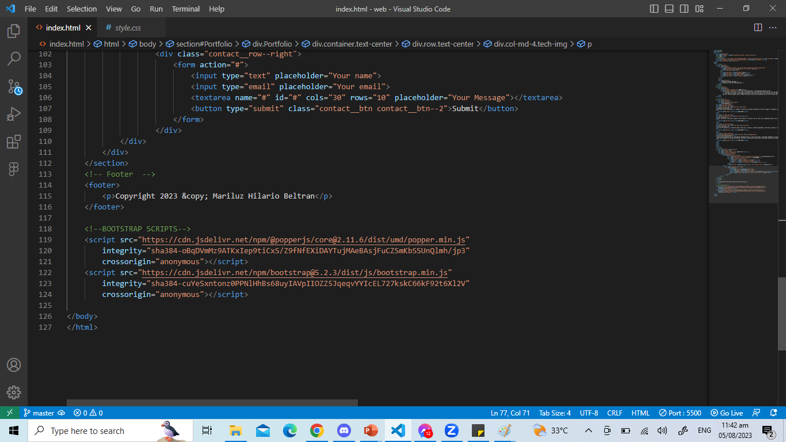
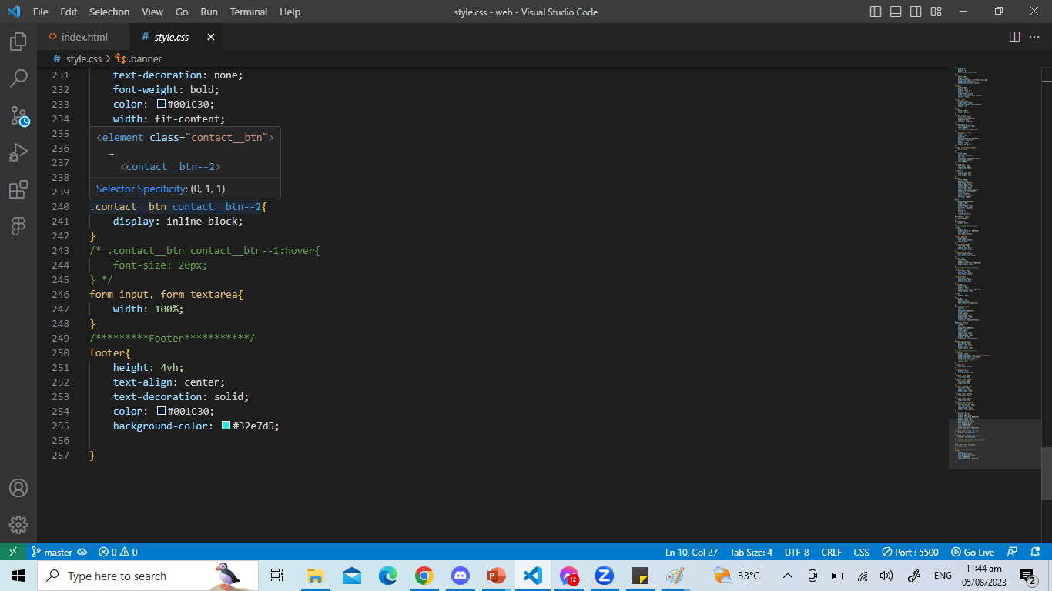
HTML
CSS

Slide 12
COMMENTS AND SUGGESTIONS:
__________________________________________________________
__________________________________________________________
__________________________________________________________
__________________________________________________________
__________________________________________________________
__________________________________________________________

Slide 13
THANK YOU FOR WATCHING.

